Slide 1

Under the Guidance of
Dr. Monica R. Mundada
Associate Professor
M S Ramaiah Institute of Technology, Bangalore-54
(Autonomous Institute, Affiliated to VTU)
Analysis of Congestion with Varying Buffer Size To Improve QoS in Multipath Multihop WSN
DESAI PRANAV B. 1MS14SCN04
2014-16 BATCH
M.TECH (CNE)
DEPARTMENT OF COMPUTER SCIENCE AND ENGINEERING

Slide 2
Abstract
In Wireless Sensor Networks (WSN), Quality of Service (QoS) assumes a critical role as networks performance is relies on QoS only. Congestion is one basic and important subject which has drawn consideration of many researchers. Congestion results into decreased network performance. So, congestion must be decreased to enhance QoS and lifespan of a network. This proposed algorithm may reduce the congestion and gives an effective solution. It establishes multiple paths from each sensor node to the cluster head and passes it to a ‘traffic node’ that manages the congestion and then sends it to base station.

Slide 3
Introduction
Wireless Sensor Networks (WSNs) are generally collection of at least one sink and ten huge number of sensor nodes scattered in a physical space. Other than in military fields it can also use in farming sector, security services, telecommunication, home automation etc.
In wireless sensor networks, multiple flows from data collecting sensors to an aggregating sink could traverse paths that are largely interference coupled. These interference effects manifest themselves as congestion, and cause the flows to experience high packet loss and arbitrary packet delays.

Slide 4
Congestion
Congestion results into less throughput and also drains the battery of the node, which is a limited resource in WSN. So, congestion is very important for QoS of a network.
There are multiple cluster heads are available in WSN. Each of the cluster heads collects the data from respective cluster’s nodes and forwards the aggregated data to base station. Cluster heads are receiving the packets from the member of the cluster.

Slide 5
QoS Policies
Throughput
Delay
Packet Delivery Ratio
Jitter
Energy

Slide 6
Introduction- TIMMH
Throughput Improved Multipath Multihop Hierarchical Algorithm
TIMMH routing algorithm describes the route of data packets in a hierarchical structure where the some group of nodes can make a form of cluster. Thus algorithm designed to improve throughput of the WSN. With consideration of Energy Aware Multihop Multipath Hierarchical (EAMMH) Protocol, TIMMH improves throughput. TIMMH has introduced the ‘Traffic Node’ between base station and cluster head. There are four kind of nodes needs to identified. (1) Sink Nodes, (2) Cluster Heads, (3) Traffic Nodes, (4) Base Station.

Slide 7
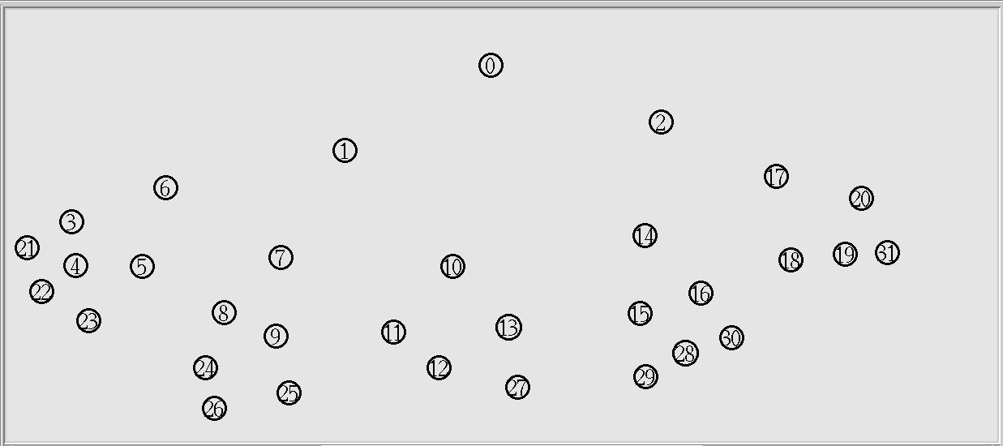
Node Placement on Plane
Figure 1 30 Nodes

Slide 8
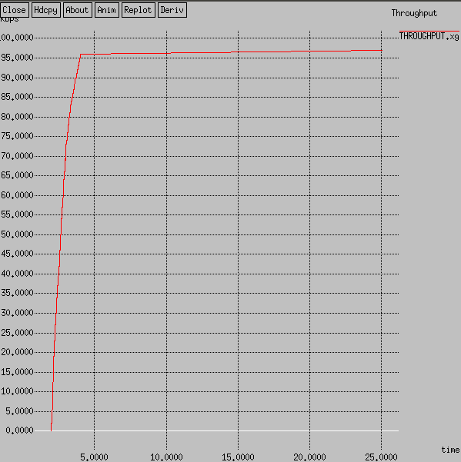
Throughput
Figure 2 Throughput for 30 Nodes

Slide 9
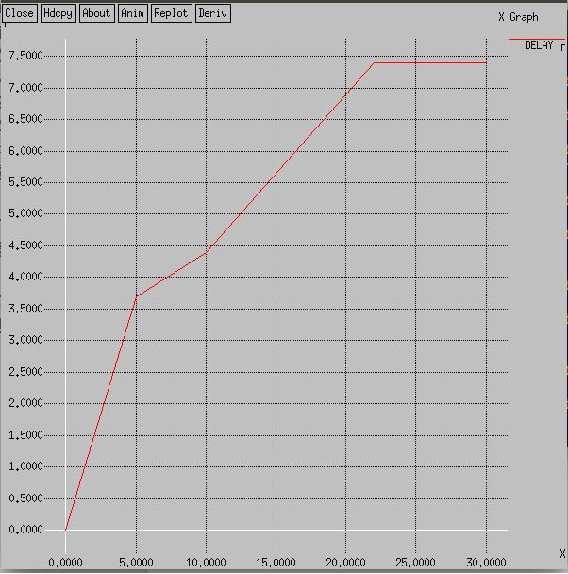
Delay
Figure 3 Delay for 30 Nodes

Slide 10
EAMMH-Energy Aware Multipath Multihop Hierarchical Protocol
EAMMH protocol arranges the sensor nodes into clusters and forms a multihop intra-cluster network [1]. It builds up various ways from every sensor node to the cluster head and gives an energy aware heuristic function to choose the optimal path.
WSN have unique attributes, for example denser level of node deployment, higher unreliability of sensor nodes and severe energy, computation and storage constraints which exhibit many challenges in the development and application of WSN [1].

Slide 11
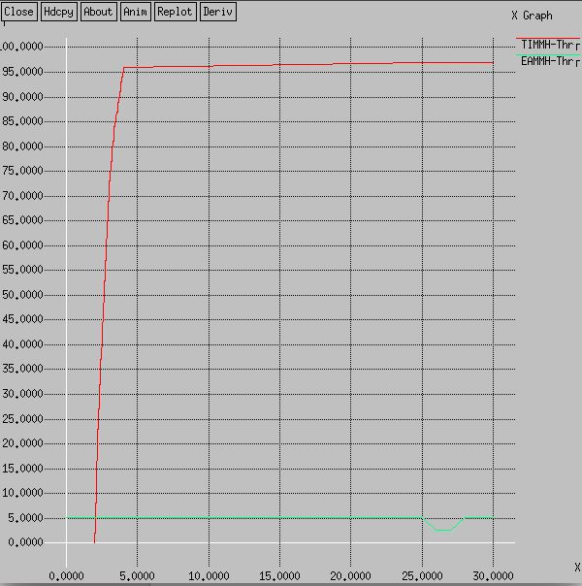
Throughput Comparison
Figure 4 Throughput Comparison

Slide 12
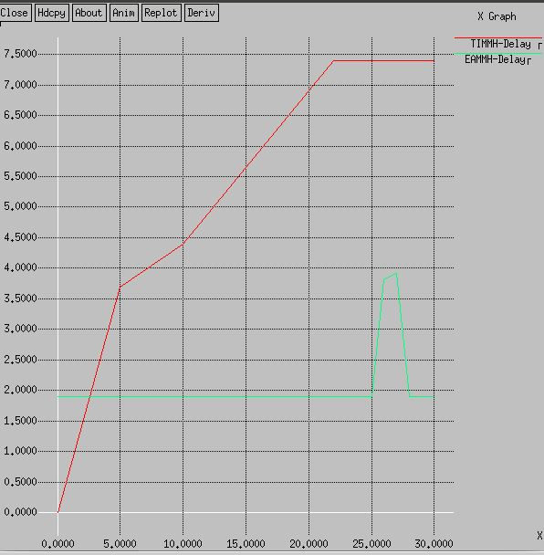
Delay Comparison
Figure 5 Delay Comparison

Slide 13
Conclusion
In this project, we presented Throughput Improved Multihop Multipath Hierarchical Algorithm (TIMMH). It has ability to improve Throughput and PDR. Both theoretical analysis and simulation results show that it has a better routing performance than EAMMH. We have also seen higher delay but it gives higher Throughput and PDR. Delay causes because of the multiple paths, cluster interoperation with Traffic Nodes and security are yet to be resolved successfully for cluster and tree based routing algorithm. Security is also improved compared to EAMMH as the attacker may not know the real location of the base station.

Slide 14
References
[1] Monica R. Mundada, V. CyrilRaj, T. Bhuvneshwari, “Energy Aware Multihop Multipath Hierarchical Routing Protocol for Wireless Sensor Network”, European Journal of Scientific Research ,ISSN 1450-216X Vol. 88 No 4 October, 2012, pp.520-530
[2] Monica R. Mundada, Pranav B. Desai, Meeradevi, “A Survey of Congestion in Wireless Sensor Networks”, International Conference on Advances in Human Machine Interactions (HMI-2016) 3-5 March-2016, DOI: http://dx.doi.org/10.1109/HMI.2016.7449195
[3] Almir Davis, Hwa Chang, “A SURVEY OF WIRELESS SENSOR NETWORK ARCHITECTURES”, International Journal of Computer Science & Engineering Survey (IJCSES) Vol.3, No.6, December 2012.
[4] Ghanavati S., Abawajy J., Izadi D., “A Fuzzy Technique to Control Congestion in WSN”, The International Joint Conference on Neural Networks (IJCNN), 2013.
[5] N. Thrimoorthy and Dr. T .Anuradha, “A Review on Congestion control Mechanisms in Wireless Sensor Networks” Int. Journal of Engineering Research and Applications ISSN : 2248-9622, Vol. 4, Issue 11( Version 2), November 2014, pp.54-59
[6] Raheleh Hashemzehi, Reza Nourmandipour, Farokhkoroupi, ”Congestion in Wireless Sensor Networks and Mechanisms for Controlling Congestion”, Indian Journal of Computer Science and Engineering (IJCSE),Vol. 4 No.3 Jun-Jul 2013
[7] Attiuttama, Kanojia Sindhuben Babulal, “An Approach for Congestion Control in Wireless Network using Sliding Window” , International Journal of Innovative Research in Computer and Communication Engineering, ISSN(Online): 2320-9801, Vol. 3, Issue 10, October 2015, pp.9526-9532
[8] Prof. Sachin Patel Prof. Rakesh Pandit Mr. Abhijeet Rathod, “Various Techniques Use In Wireless Sensor Network For Congestion Control”, International Journal of Advanced Research in Computer Engineering & Technology (IJARCET) Volume 3 Issue 3, March 2014, pp. 771-774
[9] Raheleh Hashemzehi, Reza Noormandipour, “Congestion of Technical Features of Transport Protocols for Wireless Sensor Networks”, Greener Journal of Internet, Information and Communication Systems ISSN: 2354-2373 Vol.1 (1), January 2013, pp. 33-39

